Slide 1
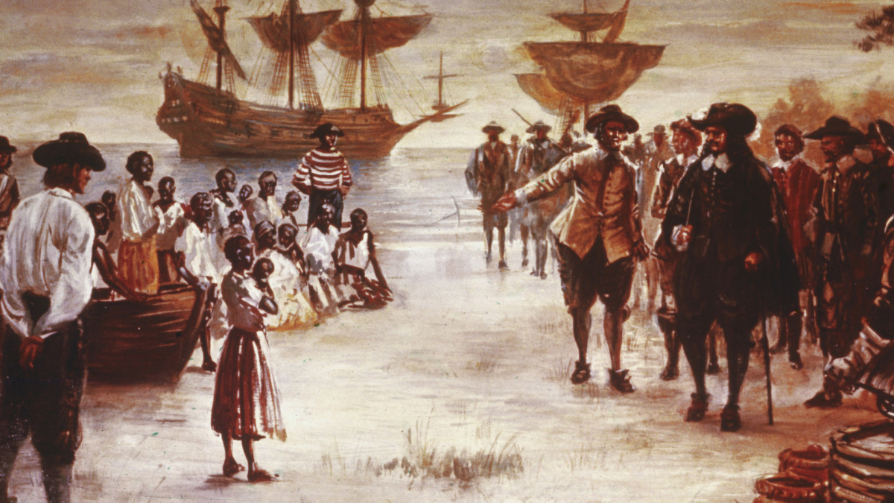
Step 1: Label 10-15 words in the picture (paste your picture here)
Striped shirt
arrivals
sky
ship
sea
black
The arrival of africans picture.
boat
hat
Shirt buttons
baby
European suit
child
skirt
brown
white

Slide 2
Step 2: Categorize your words (3-5 categories)
Category | Words
clothing | A hat,shirt buttons,striped shirt,a skirt,European suit .
Words that starts with the letter s | Striped shirt,ship,sea,sky,Shirt buttons,skirt.
People categorization | child , baby,arrivals
Colors | White ,brown ,black
Transportation type | ship,boat

Slide 3
Step 3: Write 10 sentences using your words
The child wearing a skirt is holding a baby.
One of the africans is wearing a striped shirt in the picture.
There are some ships in the sea.
The brown boat is on the land .
The floor is white in the picture of arriving Africans.

Slide 4
Step 3: Write 10 sentences using your words
6.Some of the guys are wearing a European suit.
7.Some of the European suits have buttons.
8.The sky is kind of cloudy when the Africans arrived.
9.One of the europeans are wearing a black hat.
10.The people arriving are at the left of the picture.

Slide 5
Step 4: Categories your sentences (3-5 categories)
Category | Sentences
Clothes | The child wearing a skirt is holding a baby. One of the Africans is wearing a striped shirt in the picture. Some of the guys are wearing European suits. Some of the European suits have buttons. One of the Europeans is wearing a black hat.
Sea transportation | There are some ships in the in the sea. The brown boat is on the land.
Sentences that included the word arrive | The floor is white in the picture of arriving Africans. The sky is kind of cloudy when the Africans arrive. The arrivals are at the left of the picture.
Sentences with the word europeans | Some of the guys are wearing a European suit. Some of the European suits have buttons. One of the Europeans is wearing a black hat.
Sentences that included colors | The brown boat is on the land . The floor is white in the picture of arriving africans. One of the europeans is wearing a black hat.

