Slide 1
Methods of Applied Mathematicians
By: Katelynn, Camille, Katelyn
Notes:
D- Camille
E- Katelynn
F- Katelyn

Slide 2
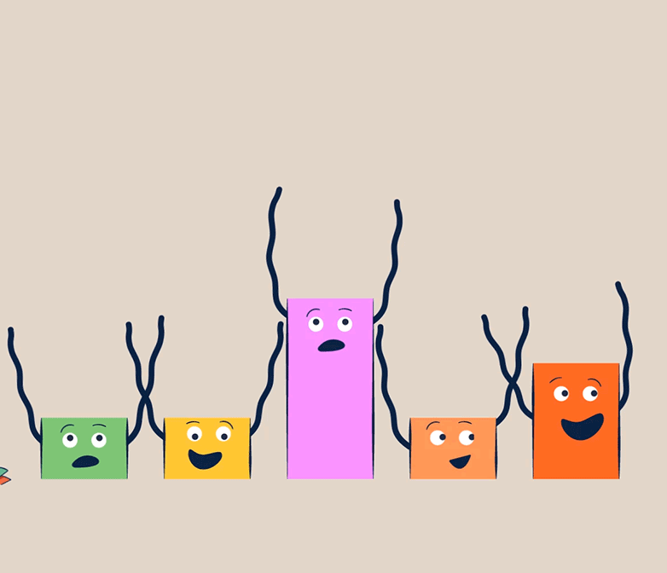
What Is It
Putting math in your house
EX: You have one book but your mom and dad gives you another one how many books do you have
“What math should we use?”
“How do you know?”

Slide 3
Example:
Wanting a toy ball that cost $10
Save up money
Ask mom and dad for money
Keep on doing that and later you can buy the toy

Slide 4
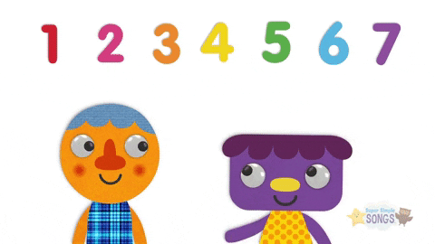
How it can be used
Can be used when you don’t know what to do
Counting
Solving problems
Math
4 2

