Slide 1
By:
KNOWLEDGE & INDIGENOUS SOCIETY
Scope: Starburst Identity Chart
Julia & Miguel

Slide 2
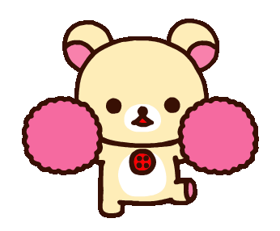
What Is It?
Starburst Identity Chart…
It’s a way to show how you think of yourself (also what you think is important in your life), and how others think of you

Slide 3
A Specific Example
Koko thinks Riri is a nice bear. That means the word “nice” would point the arrow inside.
Riri himself thinks he is a lazy bear. That means the word “lazy” would point the arrow outside.
THE ARROWS POINTING INSIDE A CIRCLE COMES FROM PEOPLE
THE ARROWS POINTING OUTSIDE A CIRCLE COMES FROM YOU
(What Koko thinks)
(What Riri thinks)
Nice!
Lazy!

Slide 4
How Can We Use It?
This is an empty starburst chart, try it yourself. How do you think others see you? (Arrows in) How do you see yourself? And what do you think is special in your life? (Arrows out)
The Starburst Identity Chart is important because it helps you know who you are, and the things around you, since you grow up in a lot of different groups. Using it will help you understand the good things in your life.
…
…
…
…
You!
…
…
…
…
Notes:
Do you think it’s important to be happy? If yes, then write that down on the arrow pointing outside

