Slide 1
Research Shows That Students’ Setting Their Own Goals Can Lead To Increased Intrinsic Motivation &, with ELLs, Increased Language Learning.

Slide 2
Tried At Least Ten Different Kinds Of Goal Sheets (see Padlet for examples)
Conclusion: Any short form will do - the key is creating time for initial teacher/student conversation & time for regular review.

Slide 3
I ask ELL students where they are on line:
Doing nothing to learn English
0______________________________100
Doing Everything to Learn English

Slide 4
Where Do They See Themselves Ten Years From Now, Twenty Years From Now, Thirty Years From Now?
What can they do now to achieve those dreams?

Slide 5
Have Also Tried “Individual Student Learning Plan” Involving Parents/Guardians
Asset, not Deficit, Based

Slide 6
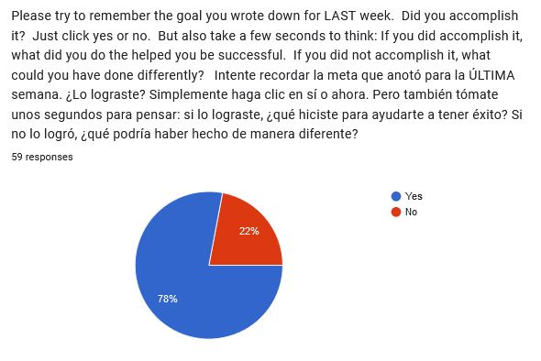
Also Used Simple Weekly Google Forms Goal

Slide 7
Conclusions:
Initial Conversation Is Critical - even if goal setting process falls apart, a lot of good can still come out of it
Sharing many goal-setting examples (& actions to achieve them) is critical, or else students may feel lost.
Work hard at figuring out a regular time students can reflect on progress they’ve made, and goal changes they might want to make. Include time for sharing.
Throw a bunch at wall & see what sticks

Slide 8
Elements Of Student Goal-Setting To Enhance Chances Of Success:
Incorporate Reflection on What They’re Doing Now (Assets)
Include Long-Term, as well as Short-Term Goals
Have students identify specific actions they can take to achieve their goals
Keep it short-&-sweet
Schedule Regular Check-Ins
Normalize Adjusting Goals

